Slide 1
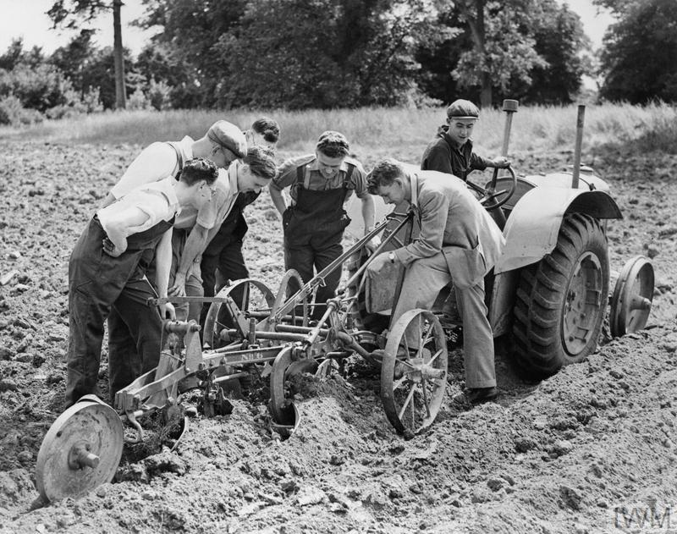


COs and the Second World War
‘Britain’s Home Front, 1939–1945: Conscientious Objectors’. © IWM (HU 36259)
Notes:
Teacher’s Notes: This lesson explores the lives, experiences, and work of Britain’s Second World War COs. It provides an overview of why COs rejected military service and asks pupils to explore some of the attitudes towards COs. It looks at how professing an objection to war could affect relationships between COs, their friends, and their family members. The lesson also encourages pupils to think about some of the ways in which registering as a CO impacted upon individuals emotionally – particularly in relation to feelings of doubt and uncertainty. As the stories contained within the CO map reveal, COs were mistreated and drew criticism in certain quarters on occasion, but there was far more tolerance towards objectors than in the First World War.

Slide 2
Activity 1
Read through the case studies on the CO map on the home page and answer the following questions:
What are some of the reasons that COs objected to fighting during the Second World War? How many different examples can you find?
How were COs treated by friends, family members, and in society?
How were COs treated within the military?
How did the First World War influence Second World War COs?
Do you think it would be difficult or easy to be a CO? Explain your answer.
Was there a particular story that you found interesting or moving? If so, why?
Did reading about COs add to or change your understanding and knowledge of the Second World War in Britain?

