Slide 1
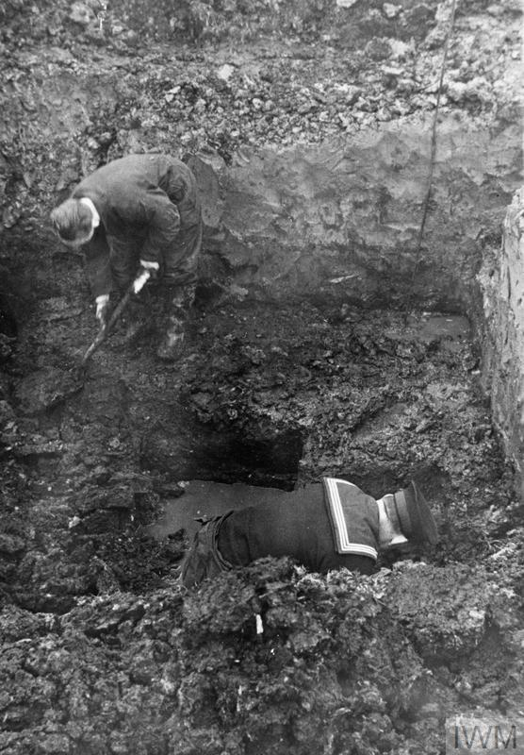


COs and the Home Front
A conscientious objector serving with the Royal Engineers bomb disposal squad and a naval rating during the Second World War. © IWM (HU 58432)
Notes:
Teacher’s Notes: This lesson asks pupils to develop their understanding of the Second World War Home Front by exploring the lived experiences of British COs. While COs were, on occasion, accused of cowardice or as having shirked their ‘duty’, many made important non-military contributions to the nation. By using the CO map, pupils will examine the work carried out by COs and discover that many objectors were driven by humanitarian impulses and a desire to relieve the suffering caused by war. In doing so, COs were often willing to expose themselves to risk and danger.

Slide 2
Activity 1
Read through the case studies on the CO map and answer the following questions:
What sort of work were COs involved in on the Home Front? How many different examples can you find? Make a list and compare with classmates.
How did COs help those suffering from the effects of war in Britain?
Did COs make an important contribution to the national war effort?
Were COs always satisfied with the work they were carrying out?
Although COs did not serve in a military capacity, were they ever exposed to risk and danger in their work? If so, what risks did COs face?

