Slide 1
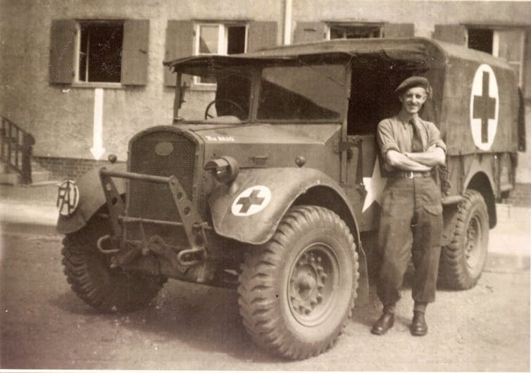


COs and the Second World War beyond Britain
‘Friends Ambulance Unit ambulance driver, with his vehicle in Wolfsburg, Germany’ at the end of the Second World War: Wikimedia Commons/Vernon39
Notes:
Teacher’s Notes: By using the interactive map on the website, students will explore the rich and diverse experiences of British Second World War COs across the globe. COs worked as teachers in Ethiopia; were involved in humanitarian and relief work in Austria and Germany; served in anti-typhus research units in North Africa and Italy; contributed to the distribution and transport of medical supplies in Burma and China; worked in ambulance units in the evacuation of Dunkirk and on D Day; provided relief at concentration camps such as Bergen-Belsen; and spent time as prisoners of war. In examining these stories, students will gain an understanding of the international activities of British COs throughout the Second World War.

Slide 2
Activity 1
Using the CO map, choose one CO that is interesting to you and follow the link to their story on the Imperial War Museum Sound Archive.
Read the ‘object’ and ‘content’ description and make a list of all the different places that your CO served during the war.
Compare and contrast the experience of your CO with that of your classmates. Are there any similarities between their war experiences? Any differences? Did your CO serve only in Britain or in other places across the world?

Slide 3
Activity 2
Read through the case studies on the CO map and answer the following questions:
What roles did COs serve in outside Britain during the Second World War?
What was the Friends Ambulance Unit? Where did men serve while with the FAU?
What was the Royal Army Medical Corps? Where did men serve while with the RAMC?
As was the case domestically, men in the FAU and RAMC did not contribute to the war in a military capacity, but were they exposed to danger or risk? What kind?
Do you think that the work of COs on an international level was important? Explain your answer.
Can you find any examples of COs being recognised or honoured for their bravery?

