Slide 1
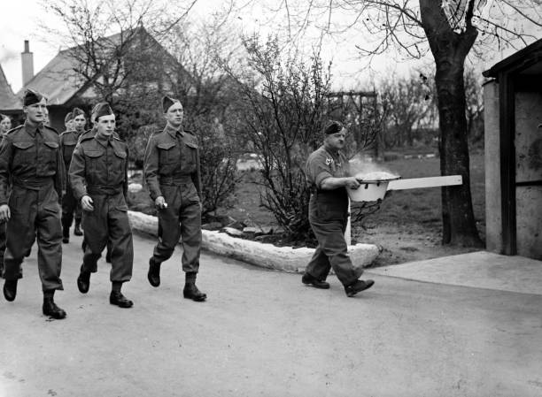


Objection, Masculinity, and War
‘British non-combatant COs’, 1940, © Popperfoto/Getty Images
Notes:
Teacher’s Notes: This lesson explores questions of manliness and masculinity during war through the lens of COs. In doing so, it uses a range of visual and written sources, as well as oral testimonies. It highlights that, while COs may not have conformed to traditional ideals of bravery, duty, and masculinity, many objectors undoubtedly displayed such virtues. More broadly, by exploring such issues, the lesson points to some of the similarities and differences between societal and governmental attitudes towards objectors in the First and Second World Wars.
For Activity 1, a handout including images and text is required (pages 3–5 of the lesson PDF).

Slide 2
Activity 1
Consider the images and text in the handout and answer the following questions:
What do the images show? Why do you think they were created?
What do the images and text tell us about ideas of duty, bravery, and masculinity in war?
What impact might such propaganda have on a) conscientious objectors and b) British society more broadly?
What do the images and text tell us about attitudes towards COs during the Second World War compared to the First World War? Were there any similarities?

Slide 3
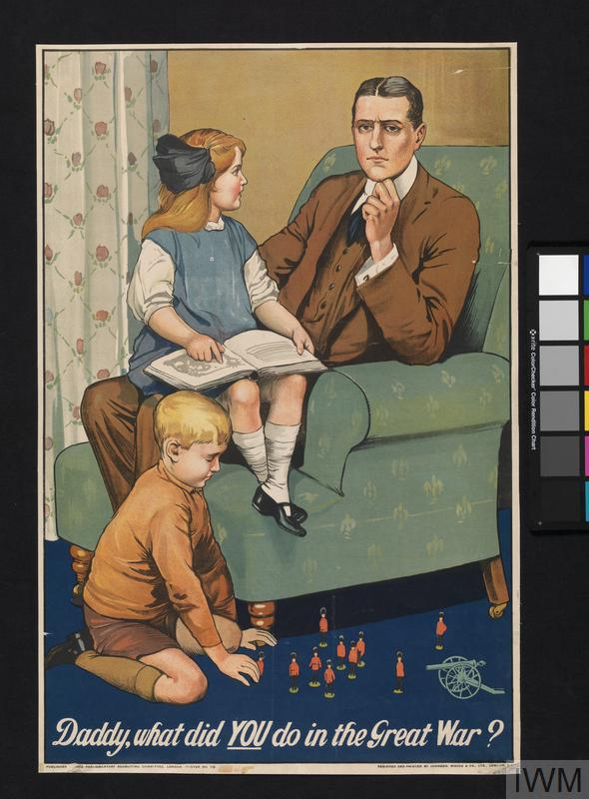
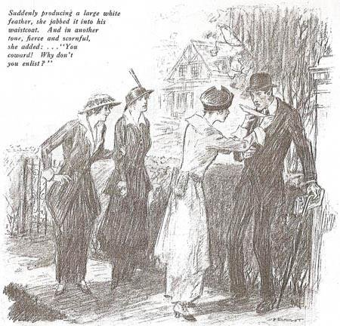
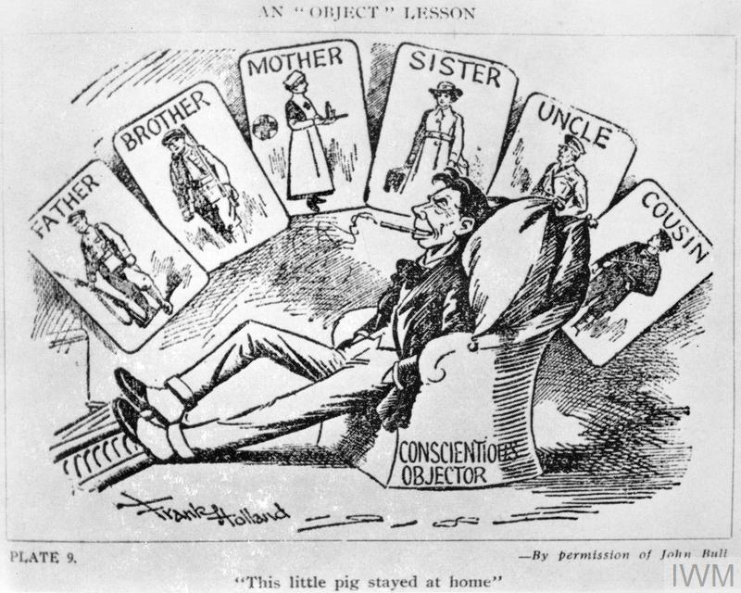
Frank Holland, ‘An “Object” Lesson’, 1914–1918, Image: IWM (Q 103334)
Arnold Bennett, ‘The White Feather: A Sketch of English Recruiting’, Collier’s Weekly, 10 October 1914
‘Daddy, what did YOU do in the Great War?’, Parliamentary Recruiting Committee Poster No. 79, 1915: Image: IWM (Art.IWM PST 0311)

