Slide 1
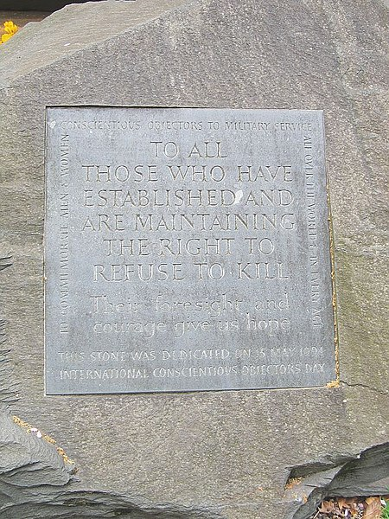


Commemoration and Conscientious Objection
Wikimedia Commons
Notes:
This lesson explores the ways in which conscientious objectors have been commemorated and memorialised since 1945. Despite numbering nearly 60,000 men, many of whom served both near the front lines and in important wartime industries and services in Britain, the CO is largely absent in the popular narrative of the Second World War and official commemorations of the conflict. This lesson encourages pupils to think about remembrance practices surrounding the Second World War in Britain and to investigate why COs might be absent from popular forms of commemoration.
For Activity 1, a handout of the two articles will be required (follow the links on page 2 of the lesson PDF).
For Activity 2, a handout of the images is needed (see pages 3–4 of the lesson PDF).

Slide 2
Activity 1
Read the handouts of The Guardian and BBC articles:
Answer the following questions:
What do the articles say about remembrance and the commemoration of war in Britain?
Do you think that COs should be commemorated in anniversaries of the Second World War? Explain your answer.
Are pacifist or anti-war voices part of mainstream remembrance practices in Britain? If not, why do you think that is?
Why might commemorating COs be considered controversial?

Slide 3
Activity 2
Look at the images in the handout and answer the following questions:
What does the inscription say?
Why do you think the CO stone might have been established?
Do you think it is an effective memorial?
How does it compare to memorials commemorating war and those who died while serving in the military during conflict in Britain? What are some of the similarities and differences?
How would you choose to commemorate COs? A monument, memorial, or something else? Explain your answer.
Notes:
While COs are not officially recognised on Remembrance Sunday, there have been broader attempts to commemorate the CO.
The images below show the Conscientious Objectors’ Commemorative Stone in Tavistock Square, London. Established by the Peace Pledge Union in 1994, the CO stone is one of the few memorials that have been created to commemorate conscientious objection. Ceremonies are held annually at the CO stone on Remembrance Sunday and on International Conscientious Objectors’ Day – a day held to commemorate those who have refused to bear arms and participate in war, both throughout history and today.

Slide 4
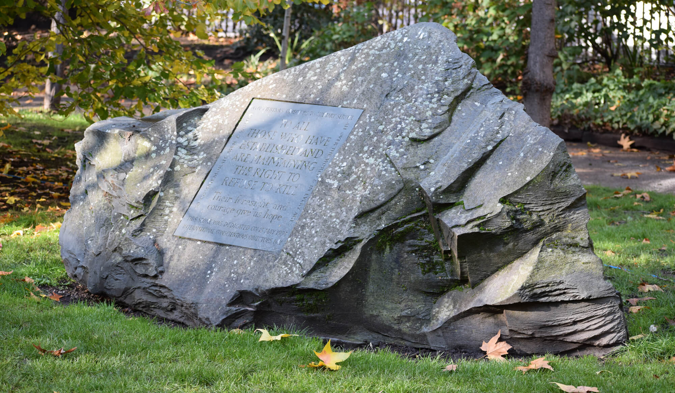
‘Conscientious Objectors’ Commemorative Stone, Tavistock Square, Bloomsbury, London, UK’: https://www.ppu.org.uk/remembrance/conscientious-objectors-commemorative-stone

Slide 5
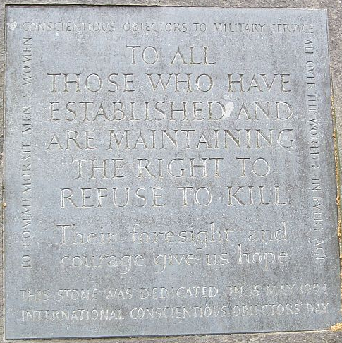
Wikimedia Commons

