Slide 1
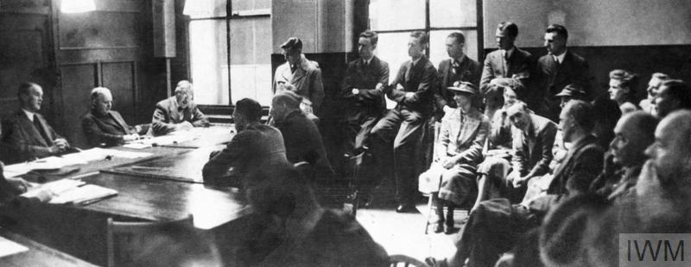


Tribunals
‘Britain’s Home Front, 1939–1945: Conscientious Objector Tribunal’. Image: IWM (HU 62359)
Notes:
Teacher’s Notes: This lesson introduces students to the structures and processes faced by individuals who wished to declare as a conscientious objector during the Second World War. In particular, it focuses on tribunals and the experiences of those who had to make their case before a tribunal panel. More broadly, the lesson encourages pupils to think about some of the pressures facing COs alongside some of the attitudes towards, and (mis)treatment of, COs.
Teachers should use the introduction section of the lesson plan (see page 1 of the PDF) to familiarise students with the idea of military tribunals, before completing the activity in the next slide.

Slide 2
Activity 1
Imagine yourself as a potential objector facing a tribunal during the Second World War:
How would you feel knowing you had to make your case before a tribunal?
How would you prepare for your tribunal?
What reasons would you give for objecting to war?
What area of (non-military) work would you like to serve in?
Would you want to serve in Britain or abroad during the war? Explain your answer.
Why do you think some COs were rejected?

