Slide 1
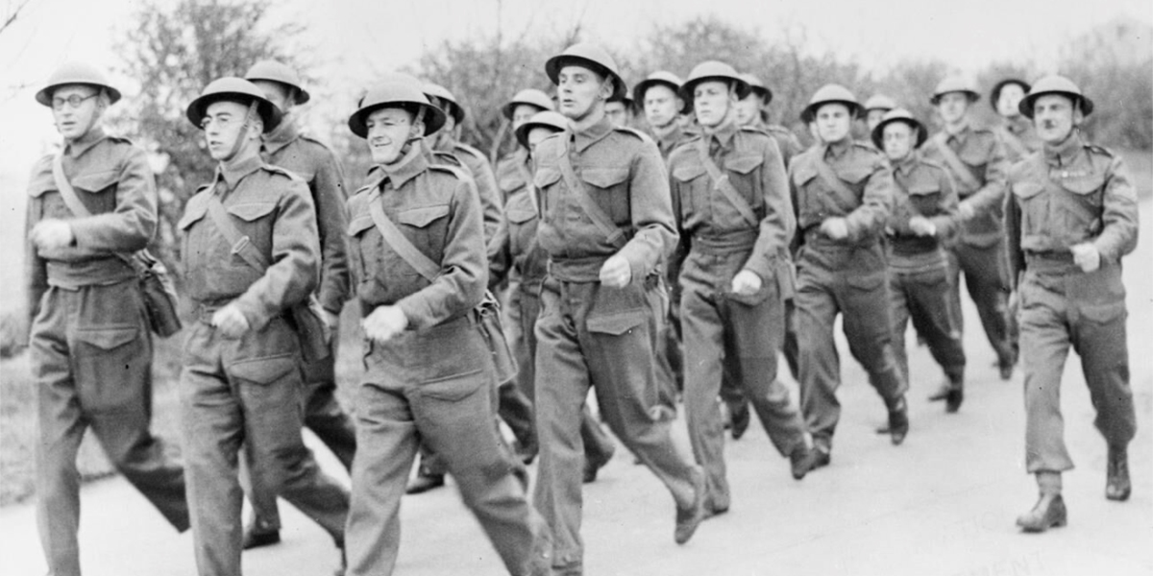


Doubt and Uncertainty in the Second World War
‘Britain’s Home Front, 1939–1945: Non-Combatant Corps’. © IWM (HU 36258)
Notes:
Teacher’s Notes: This lesson looks at the ways in which COs responded to the Second World War. Rather than focusing on themes such as pride, patriotism, or national identity, the lesson explores the moral and ethical dilemmas faced by objectors, alongside some of the familial, societal, and internal pressures placed on COs to make a military contribution to the nation’s war effort. In examining such issues, the lesson introduces students to many of the anxieties, doubts, and uncertainties felt by COs during the Second World War. Conversely, it also shows that many COs had the support of friends and families, while many (despite external pressures) remained steadfast in their objection throughout the conflict.
For Activity 1, a handout including images and text is required (pages 2–3 of the lesson PDF).

Slide 2
Activity 1
Using the CO map on the home page and the sources in the handout, answer the following questions:
What are some of the reasons which might have caused a CO to doubt their objection to war?
Were feelings of guilt and uncertainty common among COs?
What are some of the factors which might have helped COs to feel less doubt about their opposition to war?

Slide 3
Activity 2
Imagine you are a CO and the Second World War has just been declared.
Write a short diary entry attempting to capture your feelings towards the outbreak of war and some of your doubts and concerns about the conflict. Are you worried about what your role in the war will be or how you might be treated by friends, family, and members of the public?
Compare your diary entries with classmates to see if there are any similarities/differences.

