Slide 1
Energy, Justice and Poetic Resistance in Western Sahara
Dr Joanna Allan, Hispanic Studies, Durham University, joanna.allan@durham.ac.uk

Slide 2
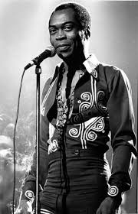
Notes:
https://www.youtube.com/watch?v=HT7uSeYHkaY
Introduce Fela Kuti and has criticisms of petroculture, neocolonialism etc., and discuss song lyrics, Kuti’s story and oil exploitation (Ken Saro Wiwa’s story) in Nigeria with students.
Discuss:
What does ‘blood oil’ mean?
Is the Nigerian case a good example of ‘blood oil’?
Introduce the IPCC report and the concept of petroculture:
“The UN Intergovernmental Panel on Climate Change (IPCC), launched its report on rising temperatures on 8 October 2018. It has been heralded as the most significant warning about the impact of climate change in 20 years. In it, the world’s leading climate scientists warn that there is only a dozen years for global warming to be kept to a maximum of 1.5C, beyond which even half a degree will significantly worsen the risks of drought, floods, extreme heat and poverty for hundreds of millions of people.
In terms of what is to be done, the report claims that we already have all the technological know-how that we need, the question is if there is political will to put them into action, and personal input with regards to lifestyle changes and behavioural patterns. That is to say, all of us need to cut back on the energy we consume, and think about what we eat and where it comes from. This is perhaps one area of the energy catastrophe that the emerging field of ‘energy humanities’ best contributes to. Studying how fossil fuels, the cause of the pending catastrophe, are represented in cultural production can help us to make visible our social, material and affective attachments to oil, argue energy humanities scholars working in within the cultural studies discipline. Most work to date (2018), to my knowledge, by cultural studies scholars working in the Energy Humanities has focused on fossil fuels.
Having read the Macdonald and Szeman readings, can anyone tell me what “petrocultures” is?”

Slide 3

Notes:
Discuss the meaning and possible scope of “Energy Humanities”
“‘Energy Humanities’ as a field is inherently interdisciplinary. If we move outside cultural studies, we can start to get a sense of how the history of energy has been embroiled with colonialism and capitalism. And by tracing that history, we can in turn begin to understand why the Energy Humanities should be engaging much more closely with renewable forms of energy.”
Discuss, with students, the Lohman reading that they have hopefully read in advance of this class, with a view to exploring the links between energy, colonialism and capitalism.
Wider discussion questions:
What is ‘energy’? How do you define ‘energy’? How do others define energy, according to the readings done ahead of class?
Does Lohman’s conclusion concur with Mitchell’s conclusion on ‘carbon democracy’? Can anyone summarise the latter reading for me?

Slide 4
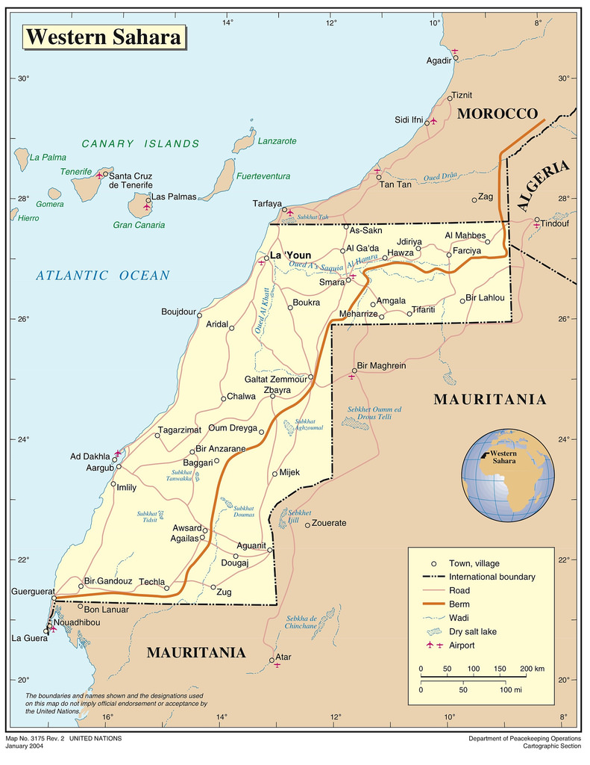
Notes:
Give a brief history of the Western Sahara conflict, and the role of natural resource exploitation in it.

Slide 5
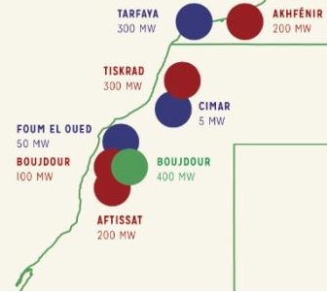
Notes:
Map is by Western Sahara Resource Watch (WSRW).
Discuss wind developments in Western Sahara (see WSRW reports for information on this e.g. https://wsrw.org/en/news/renewable-energy)

Slide 6
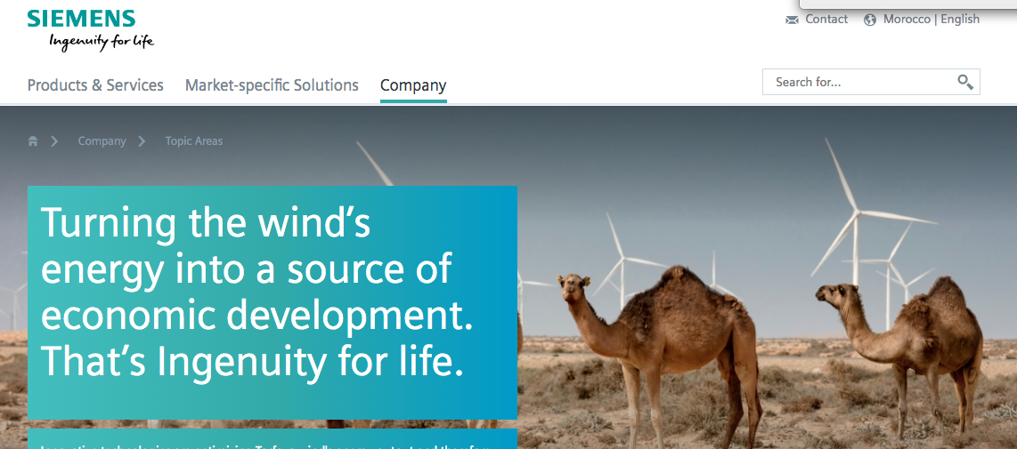
SIEMENS wind energy in ‘Morocco’ page:
http://players.brightcove.net/1813624294001/SJYnxX9G_default/index.html?videoId=5276877973001
Notes:
The Spanish company Siemens Gamesa (mostly owned by German company Siemens) is the main European player in the energy industry in occupied Western Sahara. Ask students to spend time analysing how Siemens presents its work in occupied Western Sahara (note first that Siemens calls it ‘Morocco’), and also how it presents the desert and the desert winds.
Asks students to analyse the first 20 seconds of the corporate video (see link in slide). Depending on how many students are in the class, you could ask different students to analyse different aspects e.g. the sound (sound of the wind? music?), the visuals, the use of text, how wind, sun and sand specifically are depicted?

Slide 7
SIEMENS:
The desert is “barren and desolate” (SIEMENS website, 2015, emphasis mine)
[“SIEMENS provides] great innovation to turn the waste sandy land [into] very good social, economic and ecological benefits” (SIEMENS website, 2015, emphasis mine)
“Electricity makes us human: Look anywhere in the world and you’ll find that whatever people do that makes them human is powered by electricity.” (SIEMENS online advertorial, Business Report magazine, 2018, emphasis in original)
“The human race must finally utilize [renewables] or revert to barbarism” (SIEMENS 2010 Sustainability conference, emphasis mine)
Notes:
Discuss these quotations from Siemens. Are these ‘colonial’? Do they reinforce the idea of desert as a terra nullius?

Slide 8
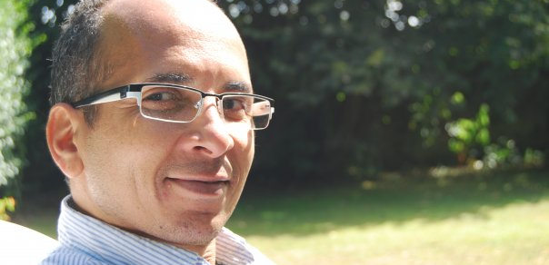
Limam Boisha
Notes:
How does Saharawi poet Limam Boisha challenge European corporate discourses on desert-as-wasteland in his poem Galb?
The poem in its original Spanish as well as in English translation is available here: https://www.oscarangelreysoto.com/post/180765614135/galb-heart-of-stone-a-traveler-asks-me-what-galb

Slide 9
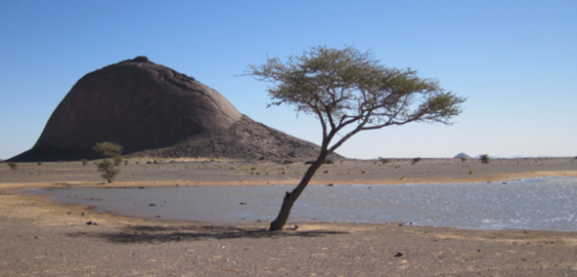
Galb

Slide 10
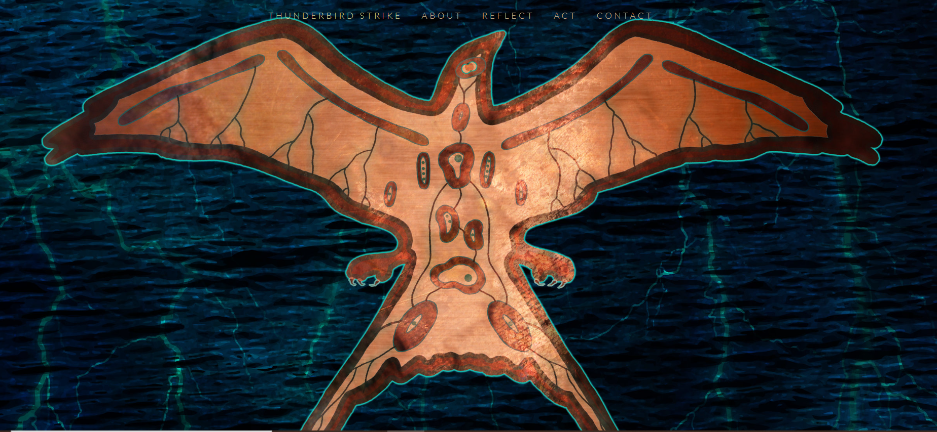
Thunderbird Strike and the Enbridge Powerlines
Notes:
Ask students to download the Thunderbird Strike game onto their phones and to have a play with it. Then, ask them to explore the Thunderbird Strike website a little. Who made the game? Why do you think they made it? What can it tell us about the links between settler colonialism and oil in North America?
Report on the Enbridge powerlines (the game protests these powerlines): https://www.sierraclub.org/sites/www.sierraclub.org/files/blog/Enbridge%20Over%20Troubled%20Water%20Report.pdf
What are the risks posed by the powerlines?
What alternatives are there to an oil-dominated future? Or to a future dominated by renewable developments led by large corporations?

